Slide 1


High Performance Cluster Computing
Architectures and Systems
Hai Jin
Internet and Cluster Computing Center

Slide 2
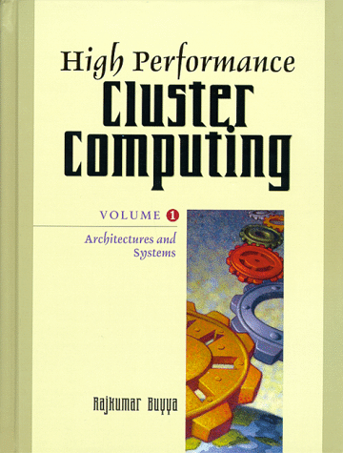
Constructing Scalable Services
Introduction
Environment
Resource Sharing
Resource Sharing Enhanced Locality
Prototype Implementation and Extension
Conclusions and Future Study

Slide 3
Introduction
A complex network system may be viewed as a collection of services
  Resource sharing
    Goal: archiving maximal system performance by utilizing the available system resource efficiently
    Propose a scalable and adaptive resource sharing service
  Coordinate concurrent access to system resources
    Cooperation & negotiation to better support resource sharing
  Many algorithms for DS should be scalable
    The size of DS may flexibly grow as time passes
    The performance should also be scalable

Slide 4
Environment
Complex network systems
  Consist of a collection of WAN & LAN
  Various nodes (static or dynamic)
  Communication channels vary greatly by static attributes

Slide 5
Faults, Delays, and Mobility
Mobility
  Yield frequent changes in the environment of a nomadic host
Need network adaptation

Slide 6
Scalability Definition and Measurement
Algorithms & techniques that work at small scale degenerate in non-obvious ways at large scale
Many commonly used mechanisms lead to intolerable overheads or congestion when used in systems beyond a certain size
Topology dependent scheme or an algorithm which is system-size dependent are not scalable
Scalability
  System’s ability to increase speedup as the number of processors increase
Speedup measures the possible benefits of a parallel performance over a sequential performance
Efficiency is defined to be the speedup divided by number of processors

Slide 7
Design Principles of OS for Large Scale Multicomputers
Design a distributed system
  Want its performance to grow linearly with the system size
  The demand for any resource should be bound by a constant which is independent of the system size
  DSs often contain centralized elements (like file servers)
    Should be avoided
  Decentralization also assures that there is no single point of failure

Slide 8
Isoefficiency and Isospeed (1)
Isoefficiency
  The function which determines the extent at which the size of the problem can grow as the number of processors is increased to keep the performance constant
    Disadvantage: its use of efficiency measurements and speedup
  Indication for parallel processing improvement over sequential processing, rather than means for comparing the behavior of different parallel systems

Slide 9
Isoefficiency and Isospeed (2)
Scalability
  An inherent property of algorithms, architectures, and their combination
  An algorithm machine combination is scalable if the achieved average speed of the algorithm on a given machine can remain constant with increasing number of processors, provided the problem size can be increased with the system size
  Isospeed
    W amount of work with N processors
    W’ amount of work with N’ processors for the same average speed, for the same algorithm
    W’ = (N’ · W) / N
    The ratio between amount of work & number of processors is constant

Slide 10
Scalability Measurement
RT: response time of the system for a problem size W
  W: the amount of execution code to be performed measures in the number of instructions
RT’: system response time for the problem of an increased size W’ being solved on the N’-sized system (N’>N)
Scalability
{
RT’
RT’
if
< 1
RT
RT
S =
1

Slide 11
Weak Consistency
The environment complex to handle
  High degree of multiplicity (scale)
  Variable fault rates (reliability)
  Resources with reduced capacity (mobility)
  Variable interconnections resulting in different sorts of latencies
Weak consistency
  Allow inaccuracy as well as partiality
  State info regarding other workstations in the system is held locally in a cache
  Cached data can be used as a hint for decision making, enable local decisions to be made
    Such state info is less expensive to maintain
    Use of partial system views reduces message traffic
    Less nodes are involved in any negotiation
Adaptive resource sharing
  Must continue to be effective & stable as the system grows

Slide 12
Assumptions Summary
Full logical interconnection
Connection maintenance is transparent to the application
  Nodes have unique identifiers numbered sequentially
Non negligible delays for any message exchange

Slide 13
Model Definition and Requirements
Purpose of resource sharing
  Achieve efficient allocation of resources to running applications
  Map & remap the logical system to the physical system
Requirements
  Adaptability
  Generality
  Minimum overhead
  Stability
  Scalability
  Transparency
  Fault-tolerance
  Heterogeneity

Slide 14
Resource Sharing
Extensively studied by DS & DAI
Load sharing algorithms provide an example of the cooperation mechanism required when using the mutual interest relation
  Components
    Locating a remote resource, information propagation, request acceptance, & process transfer policies
Decision is based on weakly consistent information which may be inaccurate at times
Adaptive algorithms adjust their behavior to the dynamic state of the system

Slide 15
Resource Sharing - Previous Study (1)
Performance of location policies with different complexity levels on load sharing algorithms
Random selection
  Simplest
  Yield significant performance improvements in comparison with the no cooperation case
  A lot of excessive overhead is required for the remote execution attempts

Slide 16
Resource Sharing - Previous Study (2)
Threshold policy
  Probe a limited number of nodes
  Terminate the probing as soon as it finds a node with a queue lengths shorter than the threshold
  Substantial performance improvement
Shortest policy
  Probe several nods & then selects the one having the shortest queue, from among those having queue lengths shorter than the threshold
  No added value to looking for the best solution but rather an adequate one
Advanced algorithms may not entail a dramatic improvement in performance

Slide 17
Flexible Load Sharing Algorithm
A location policy: similar to Threshold algorithm
Using local information which is possibly replicated at multiple node
For scalability, FLS divides a system into small subsets which may overlap
Not attempt to produce the best possible solution, but it offers instead an adequate one at a fraction of the cost
Can be extended to other matching problems in DSs

Slide 18
Algorithm Analysis (1)
Qualitative evaluation
  Distributed resource sharing are preferred for fault-tolerance and low overhead purposes
Information dissemination
  Use information of system subset
Decision making
  Reduce mean response time to resource access requests

Slide 19
Algorithm Analysis (2)
Quantitative evaluation
  Performance and efficiency tradeoff
    Memory requirement for algorithm constructs
    State dissemination cost in terms of the rate of resource sharing state messages exchanged per node
    Run-time cost measured as the fraction of time spent running the resource access software component
    Percent of remote resource accesses out of all resource access requests
  Stability
    System property measured by resource sharing hit-ratio
    Precondition for scalability

Slide 20
Resource Sharing Enhanced Locality
Extended FLS
  No message loss
  Non-negligible but constrained latencies for accessing any node from any other node
  Availability of unlimited resource capacity
  Selection of new resource providers to be included in the cache is not a costly operation and need not be constrained

Slide 21
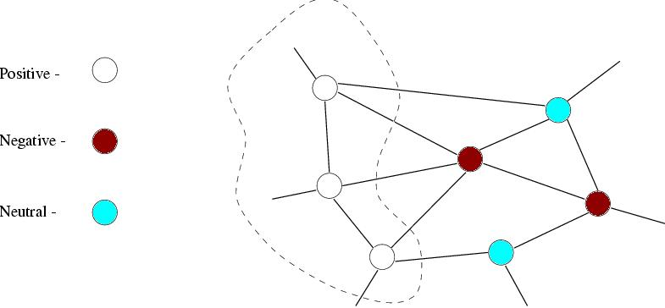
State Metric
Positive: surplus resource capacity
Negative: resource shortage
Neutral: not participate in resource sharing

Slide 22
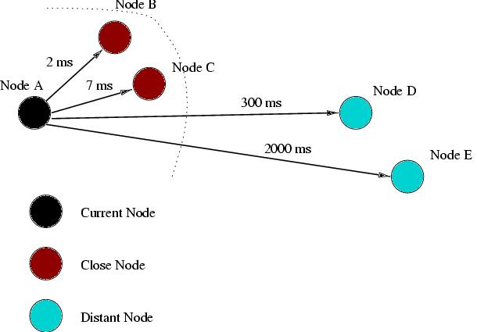
Network-aware Resource Allocation

Slide 23
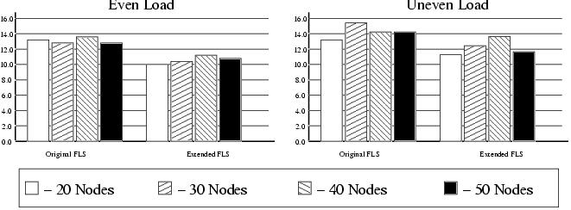
Considering Proximity for Improved Performance
Extensions to achieve enhanced locality by considering proximity
Response Time of the Original and Extended Algorithms (cache size 5)

Slide 24
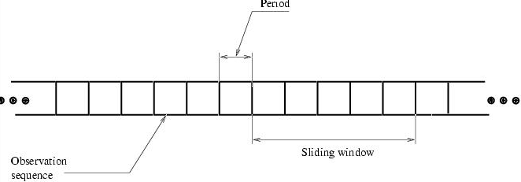
Estimate Proximity (Latency)
Use round-trip message
Communication delay between two nodes
Observation sequence period

Slide 25
Estimate Performance Improvement
Percentage of Close Allocations
System Size
Original FLS(%)
Extended FLS(%)
15
38
49
Scalability Metric for
the Even Load Case
20
40
53
30
37
51
40
39
52
20
30
40
50
50
34
49.66
20
1
0.97
0.93
0/96
30
1
0.96
0.99
Performance Improvement of Proximity Handling
40
1
1
System Size
Even Load (%)
Uneven Load (%)
50
1
15
17.99
12.36
20
21.33
16
30
19.76
21.67
40
19.15
21
50
19.45
18.55

Slide 26
Prototype Implementation and Extension
PVM resource manager
  Default policy is round-robin
  Ignore the load variations among different nodes
  Cannot distinguish between machines of different speed
Apply FLS to PVM resource manager

Slide 27
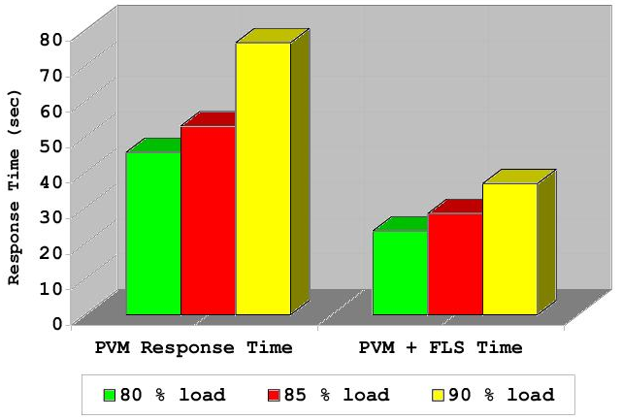
Basic Benchmark on a System Composed of 5 and 9 Pentium Pro 200 Nodes (Each Node Produces 100 Processes)

Slide 28
Conclusions
Enhance locality
Factor influencing locality
  Considering proximity
  Reuse of state information

